Slide 1
Basics of C# Programming

Slide 2
1. C# Language and .NET Platform
What is this?
C# (pronounced C sharp) is a modern, object-oriented programming and a strongly typed language developed by Microsoft. It is part of the .NET framework, providing a powerful platform for building Windows applications, web applications, and more.
How/where can I use this?
C# is widely used for developing various applications, including desktop applications, web applications (using ASP.NET), mobile applications (using Xamarin), cloud-based applications, and game development (using Unity).

Slide 3
2. Variables/Переменные
What is this?
Variables are containers for storing data values. In C#, you must declare a variable before using it, specifying its type.
How/where can I use this?
Variables are used to store and manipulate data in your program, making it dynamic and adaptable.
Example:

Slide 4

3. Data Types
What is this?
Data types define the type of data a variable can hold. C# supports various data types, including int, double, string, etc.
How/where can I use this?
Choosing data types is crucial for efficient memory usage and accurate data representation in your program.
Example:

Slide 5

4. Static variables and Constants
What is this?
Static variables are shared among all instances of a class, while constants are values that cannot be changed.
How/where can I use this?
Use static variables for data shared across instances, and constants for values that should not be modified.
Example:

Slide 6

5. Console Input/Output
What is this?
Console input/output functions allow interaction with the user through the console.
How/where can I use this?
Useful for debugging, simple user interfaces, and text-based applications.
Example:

Slide 7
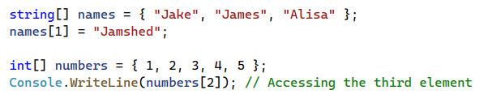
6. Arrays/Массивы
What is this?
Arrays are used to store multiple values of the same type under a single variable name.
How/where can I use this?
Useful when dealing with collections of data, like lists of numbers, names, etc.
Example:

Slide 8
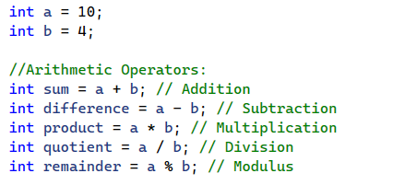
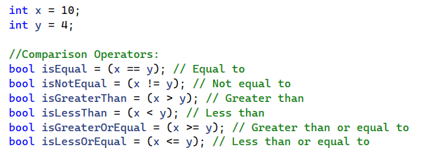
7. Arithmetic/Comparison Operators
What is this?
Operators perform operations on variables and values. Arithmetic operators handle mathematical operations, while comparison operators compare values.
How/where can I use this?
Basically, for mathematical calculations and conditional statements.
Example:

Slide 9
8. If...Else and Switch Case
What is this?
The if...else statement allows the program to make decisions based on a given condition. If the condition is true, the code inside the 'if' block is executed; otherwise, the code inside the 'else' block is executed.
The switch case statement is another way to handle multiple conditions. It compares the value of an expression against possible constant values and executes the code block associated with the first matching value.
How/where can I use this?
Use if...else statements to create branching logic based on specific conditions.
Use switch case when you have a variable with discrete values and want to execute different blocks of code based on its value.

Slide 10
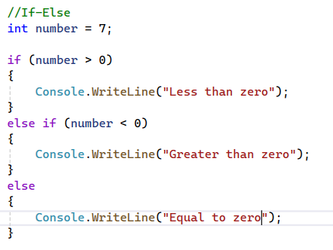
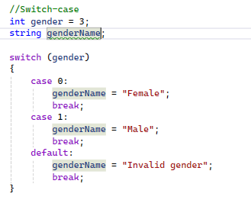
Examples of If...Else and Switch Case

Slide 11
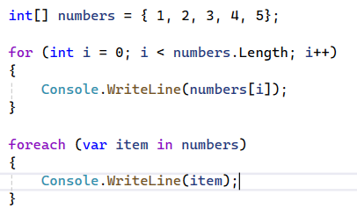
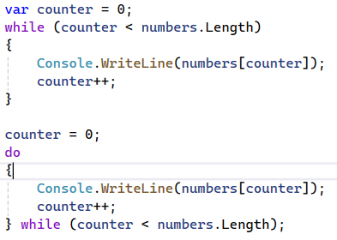
9. Loops (For, Foreach, While, Do-While)
What is this?
Loops are structures that repeat a block of code until a specific condition is met.
How/where can I use this?
Useful for iterating through collections, performing repetitive tasks, and controlling program flow.
Example:

Slide 12
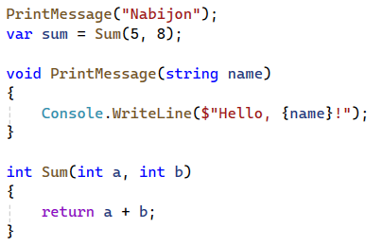
10. Methods
What is this?
Named blocks of code that can be executed by calling their name.
How/where can I use this?
Use methods to organize code into reusable and modular units.
Example:

Slide 13
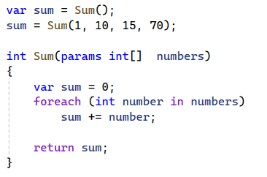
11. Method with Params Parameter
What is this?
A method that can accept a variable number of parameters.
How/where can I use this?
Use when you need flexibility in the number of arguments passed to a method.
Example:

Slide 14
12. Ref and Out Keywords in Methods
What is this?
Ref stands for "reference." When you pass a variable using ref to a method, you're passing a reference to the original variable, not a copy of its value.
Out is similar to ref, but it is designed for scenarios where the method is expected to assign a value to the parameter before it exits.
How/where can I use this?
Use ref when you want to modify the original value of a variable within a method, and you want the changes to be reflected outside the method.
Use out when you want the method to initialize the variable inside the method, and you don't require the variable to be initialized before passing it to the method.

Slide 15
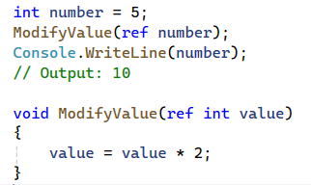
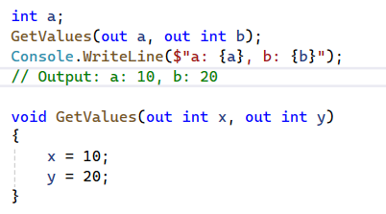
Examples of Ref and Out keywords

Slide 16
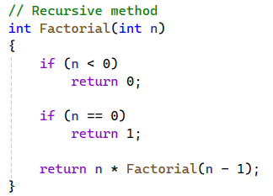
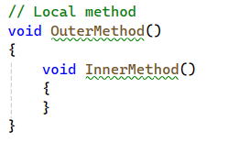
13. Local and Recursive Methods
What is this?
Methods declared within another method (local) or methods calling themselves (recursive).
How/where can I use this?
Use local methods for encapsulation or recursive methods for solving problems iteratively.
Example:

Slide 17
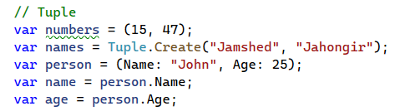
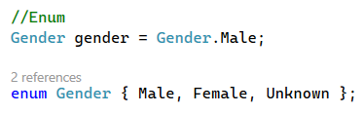
14. Tuple and Enum
What is this?
Tuple: A lightweight data structure to group multiple values.
Enum: A set of named integer constants.
How/where can I use this?
Use tuples for returning multiple values from a method, and Enums for creating named sets of constants.
Example:

